Slide 1

Statistics Canada Data Exercise
- 18th July 2022

Slide 2
Data Ingestion & Pre-Processing
1) Using Python - Pandas
2) Analysis of Dataset (Excel & Pandas)
Checking any wrong, Not Applicable, null, blanks and redundant data, etc
3) Performed Data Pre-processing
Removed redundant information – used Member ID information
Renamed the column names
No deletion of any data
Four-Region calculations: 5 digit to be considered as a subset code; used ‘ALT_GEO_CODE’

Slide 3
Four-Region Model Calculations
1) Average Total income = Total Income/ Total Population
2) Total Population – Income Statistics Member ID = 1
3) Total Average Income – Income Statistics Member ID = 5
4) Ignored Age = 1 as its Total Age for part d.

Slide 4
Heatmap- Aboriginal Population & Region

Slide 5
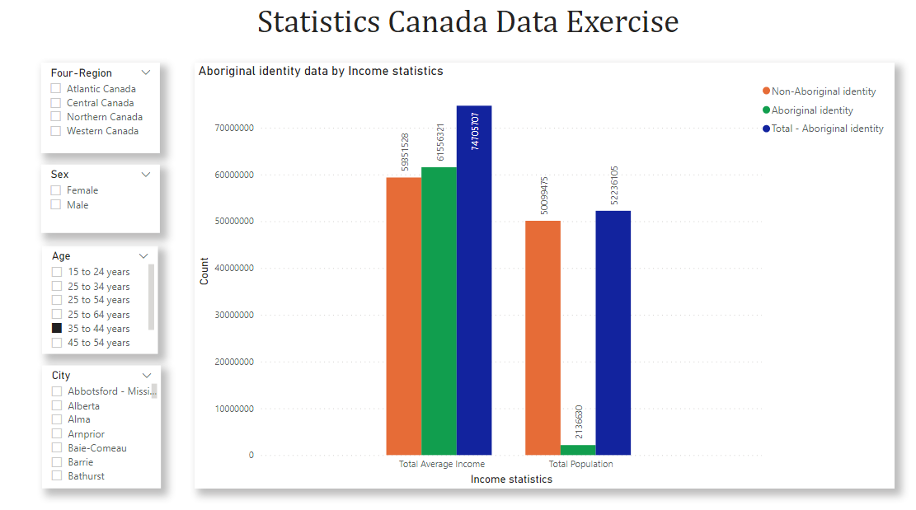
Power BI Visualizations

Slide 6
Merging of Datasets
1) Limitations of Resources – Space issue
Local system
Google Colab
2) Workaround – Taking subset of Datasets
Issue – Inconsistent results
3) Total Population – 2015 : No data, Income for 2015 and population data of 2016

Slide 7
Link: Thank you!
- Shivanika shah

